Slide 1
Teacher Student collaboration system

Slide 2
CSE 3224 : Information System Design and Software Engineering Lab
Presented by –
Mamun Or Rashid : 15-01-04-011
Atiqul Islam Chowdhury : 15-01-04-014
Mahee Mashrur :15-01-04-013
Md. Saiful Islam : 15-01-04-027

Slide 3
WHY TSCS ?
Reducing communication gap between teacher & student
Making sharing process more dynamic
Time consuming and rearranging hotchpotch things

Slide 4
Project goals
Providing a easy communicating system
Making teachers individual environment
Individual department based system
Making things more easy for everyone like
Providing study materials
Result publish
Attendance

Slide 5
Feasibilities
Technical feasibility
Economical feasibility
Operational feasibility

Slide 6
Technical feasibility
.NET Framework
To provide a consistent object-oriented programming environment
To provide a code-execution environment that minimizes software deploying and versioning conflicts
To provide CLR that comes up for solving memory management, thread management etc.

Slide 7
Technical feasibility
MySQL
Data security , High performance
Consistent modification of data
Complete Workflow control

Slide 8
Economical feasibility
Resources used here mostly are free
But initially it includes cost of programmers
Cost of studying the full scenario
Cost of ISP & server
Other costs like : electricity bill, transportation etc.

Slide 9
Operational feasibility
As it is reducing time so user will welcome it for their interest
Fast & reliable server
Services are flexible and expandable
Will increase the overall response
Support & user involvement

Slide 10
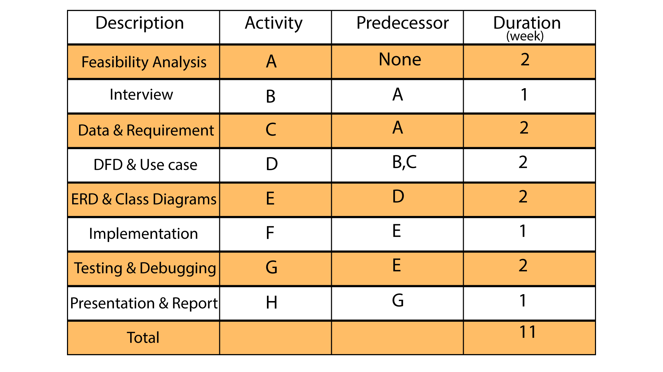
Project Scheduling

Slide 11
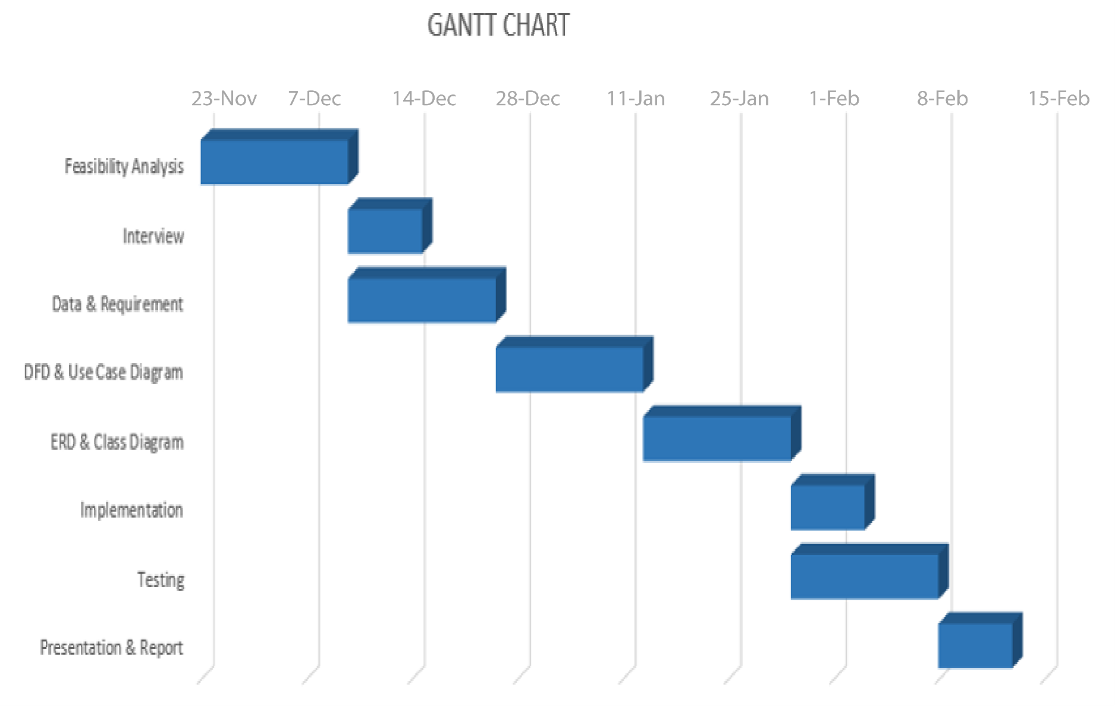
GANTT Chart

Slide 12
Risk Analysis
Server failure
Unforeseen bug and crush report
Schedule overruns
Market competition

Slide 13
Conclusion
At the end we can say its all about solving the problems Of communication between teachers and students. With its dynamic process hope we can deport sharing problems. So all the sides can get complication free information gathering way

Slide 14
Thanks !
Any question ?

